Slide 1
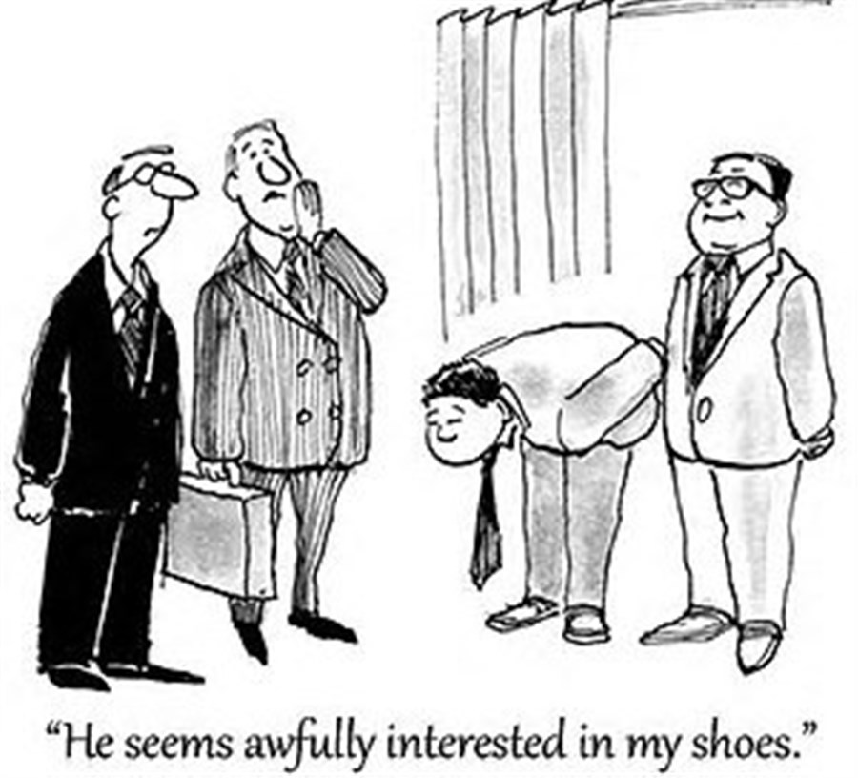
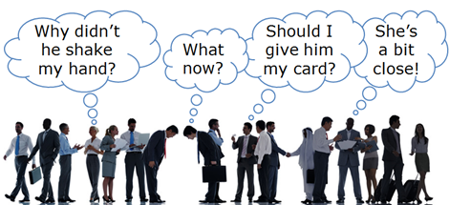
This can be the part of the presentation where you can introduce yourself, write your email…

Slide 2
CULTURAL AWARENESS
“It is not our differences that divide us. It is our inability to recognize, accept, and celebrate those differences.”
Audre Lorde

Slide 3
Learning outcomes
By the end of the session you should be able to;
Recognize the importance of cultural awareness and its role in developing one’s social intelligence.
- Discuss the consequences of poor cross-cultural awareness.
-Use idiomatic expressions.
- Use modals of deduction in the past.

Slide 4
Outline
WARM UP
DEFINITIONS
Cultural misunderstandings
Etiquette
Cultural awareness
Stages
Culture shock
stages
Grammar: modals of deduction in the past
Idioms

Slide 5
01
Warm up
Let’s Start!

Slide 6

What are some aspects of your local culture that are unique?

Slide 7
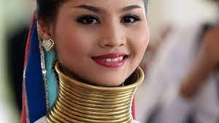
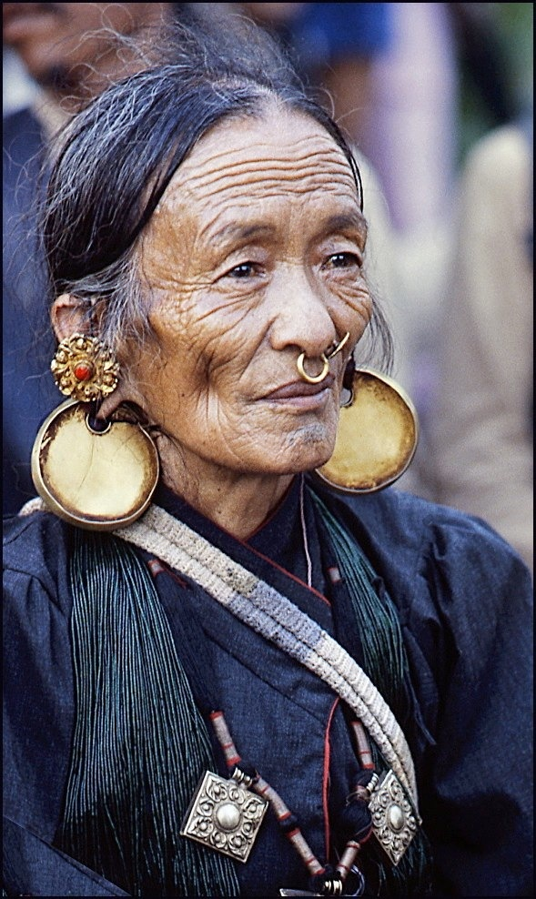
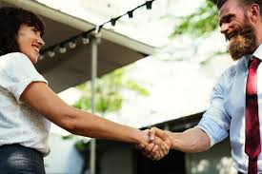
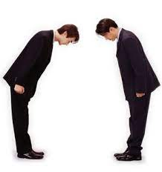
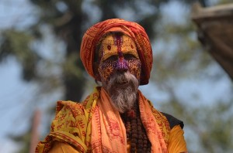
Look at the following pictures and comment on them.

Slide 8
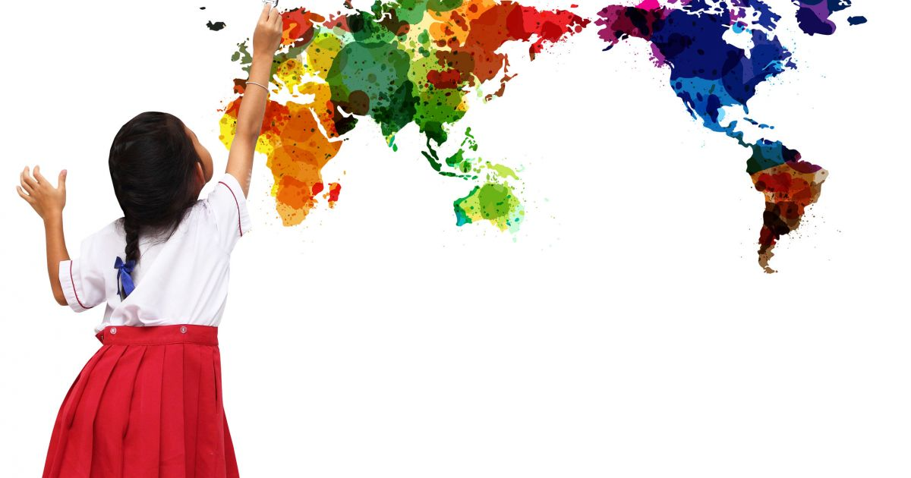
Are you culturally aware ?

Slide 9
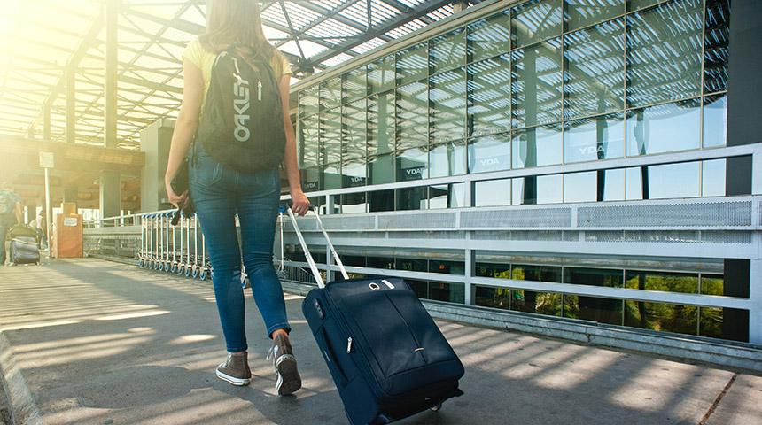
Let’s have a quiz
1. In the U.S., Canada and most European countries, you're expected to arrive ___________ for appointments or meetings.
Late
On time
Not on time
2. In Spain, you're expected to arrive ________ for most appointments or meetings.
Late
Early
On time
3. In Japan, China, Korea and Vietnam, never pass something to an older person or superior with only one hand; you're expected to use ____________ .
Right hand
Left hand
Both hands
4. In the U.S. and Canada, you're supposed to _________ if you plan to visit someone at home.
Go first without calling
Arrive early
Call first

Slide 10
5. In many Asian countries, it is _________ to visit your friends at home without invitation or prior appointment.
Acceptable
Not acceptable
Unusual
6. In Peru, Columbia, Brazil, Bolivia, and Mexico, it is common to _________ someone you have just met for the first time.
Kiss
Bow at
Ignore
7. In the U.S., Canada and many European countries, it is ____________ to eat noisily or burp loudly in front of others.
Polite
Impolite
O.K
8. You have a very exciting business opportunity in China, and your boss is bringing you and one more of your colleagues along. This is an important meeting and you want to get it right. Which of these would be a faux pas in Chinese company?
Greeting the youngest person first
Using their honorific titles and last names
Shaking hands
Greeting the most senior business associate first

Slide 11
02
Definitions

Slide 12

What is culture?
The way of life, especially the general customs and beliefs, of a particular group of people at a particular time.

Slide 13
WHERE can you find culture?
Everywhere!

Slide 14

Having an awareness and appreciation of the values, norms, and beliefs characteristic of a cultural, ethnic, racial, or other group that is not one’s own, accompanied by a willingness to adapt one’s behavior accordingly.
What does it mean to be culturally sensitive?

Slide 15
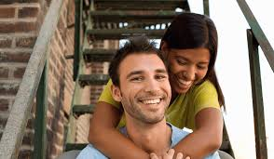
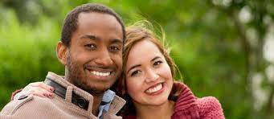
Would you consider marrying someone from another culture?

Slide 16

When something—a word, gesture, object, social context, almost anything you can think of—has different meanings in two cultures.
When do cultural misunderstandings occur?

Slide 17
03
Cultural misunderstandings
Examples and scenarios

Slide 18
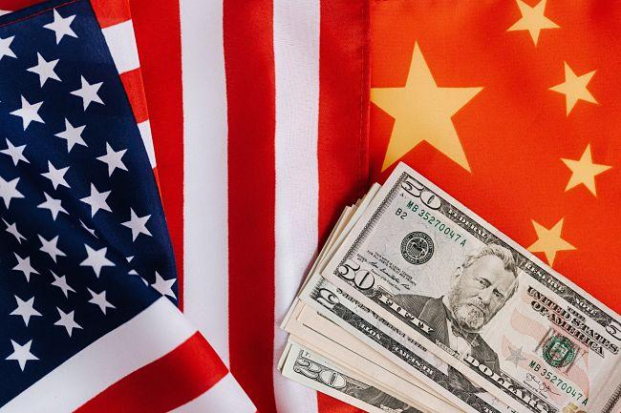
Scenario one
“Sit Where you Like” (Chinese vs. American culture)

Slide 19
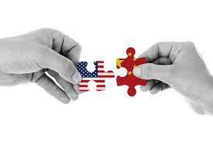
An American company selling high-end technical goods to a potential Chinese buyer.
Relations have been going well and the Chinese have been invited for a factory tour in anticipation of the contract between the two companies finally being signed.
The evening after the tour, the Americans host the Chinese delegation for a dinner at a local restaurant.
Upon entering the restaurant, the head of the Chinese delegation is greeted by a junior member of the US team. He asks where he should sit, to which he is told to, “sit where you like”.
The next day the Chinese delegation left the USA without signing any contract. Days later the US team received word that the Chinese felt humiliated and were reconsidering the business relationship.
So what happened?

Slide 20
In Chinese culture, hierarchy is really important, whereas in American culture, it’s more about equality.
So, when the head of the Chinese delegation was only greeted by a junior member of the team, rather than the most senior, he immediately felt a loss of face.
To add insult to injury he was then told to ‘sit anywhere’ – when, ideally, he should have been given the seat at the head of the table next to the most senior member of the US team. In Chinese culture, people tend to hide their feelings. For this reason, the team did not say anything at the time.
The US team had to work hard to repair the damage.
This cultural misunderstanding led to an 8-month delay in the signing of the contract.

Slide 21
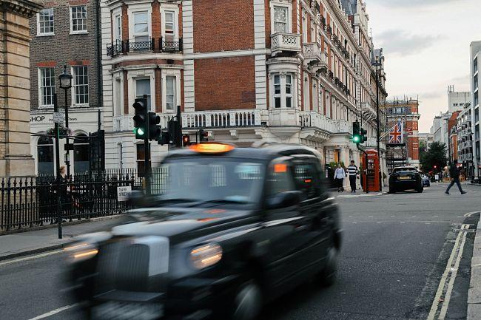
Scenario two
“It’s fine” (Dutch vs. British Culture)

Slide 22
A Dutch national who has recently moved to the UK really struggles to understand the British. For example, when they prepare a report or a presentation and show it to their manager for feedback they are told, “it’s fine”.
However, after handing in the report or making the presentation they discover the manager is not pleased as things are missing.
They can’t understand why they are being told something is fine, to only find out later, it is not fine. This along with other communication challenges is really bothering the Dutch national.
So, what’s going on here?

Slide 23
It’s all about how different cultures communicate. The Dutch are used to being open, frank and honest when giving opinions. If you say something is ‘fine’, then it’s fine.
In the UK however, the British communication culture is very different. You need to listen to much more than the words in the UK. People say one thing but mean another. Saying something is “fine” in the UK really means it is not fine – it’s the exact opposite.
Among Brits, they understand what ‘fine’ means – it means it’s 'not good enough' and that changes need to be made. The Dutch national however took the meaning literally – big mistake!

Slide 24
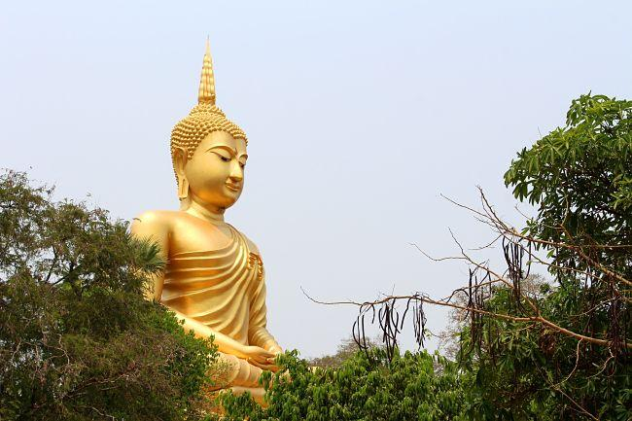
Scenario three
“I’m Just Joking!” (Australian vs. Thai Culture)

Slide 25

An Australian national moved to work in Bangkok, Thailand.
Within a very short time, the Thai nationals in the office were not very impressed with their new addition.
Complaints were being made against him for inappropriate behavior.
Most notably many of the Thais said he was rude to them. He was being given the cold shoulder by his Thai colleagues and not feeling welcome.
So, what went wrong?

Slide 26
In this example of a cultural misunderstanding the Australian was trying to make friends through humor.
He would make jokes about his Thai colleagues in front of other people.
Now in Australia this is an acceptable way of making friends.
‘Banter’ between colleagues is normal and people will make jokes about one another as a means of showing friendliness.
In Thailand however, this simply does not translate. You don’t make jokes about people in front of others, especially work colleagues.
As a result of his behavior all the Thais in the office thought that the Australian was extremely rude and insensitive; in fact, he was just trying to be friendly.

Slide 27
Cultural Misunderstandings and Values
In all three examples of cultural misunderstandings, both sides have not understood that their culture, and their way of doing things, doesn’t work in the new culture.
Much of this comes down to values and how cultures are shaped by the values they prioritize.
For example, the Chinese value hierarchy whereas the Americans value equality. The Dutch value transparency whereas the Brits value subtlety and diplomacy.
The Thais value face, reputation and formality whereas the Australians value humor, friendship and a much more informal approach to business.
All cultures prioritize different values and a lot of the time when we see examples of cultural misunderstandings its usually a case of one culture looking at another culture through their own cultural lens.

Slide 28

When in ROME do as the Romans do.
Discussion point!
Explain and comment

Slide 29
04
Culture etiquette

Slide 30

What is the meaning of cultural etiquette?
The codes of behavior that rule different cultures.
What's acceptable and what isn't in a society.

Slide 31
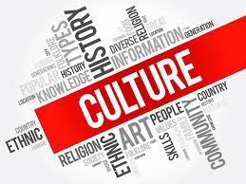
Why is cultural etiquette important?
Etiquette helps us to be thoughtful about our conduct, it helps us to be aware of the feelings and rights of others.
Etiquette helps us to get along with others, it promotes respect. Etiquette promotes respect for people of other cultures, etiquette is culturally bound.

Slide 32
The more you know about culture etiquette the more culturally aware you are.

Slide 33
05
Cultural awareness stages
What are the stages of cultural awareness?

Slide 34
Proficiency:
Unconsciously aware
Competence: Consciously aware
Sensitivity : consciously unaware
Blindness Unconsciously unaware

Slide 35
Cultural awareness: stages
Sensitivity – Consciously Unaware
We're becoming aware that there are some cultural differences
We're no longer ignorant about the fact that we might be upsetting people or offending people..
01
02
Blindness – Unconsciously Unaware
We're only aware of our own way of doing things. We're often unaware of the impact of cultural differences. We're not aware that we may be stepping on other people's toes and literally have no idea.
Competence – Consciously
Aware
We're aware of those cultural differences. We accept them. Not only do we accept the person and their beliefs, but we see the potential benefits of other people's values and beliefs. We may even choose to adopt some of these values or norms of these other groups.
Proficiency – Unconsciously Aware
We're fully aware of those cultural differences. We accept them. Not only do we accept them, but we actually welcome them. We do so without even having to really think about the process.
So, at this point, accepting others' cultures and types of diversity comes naturally.
03
04

Slide 36
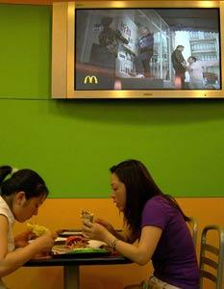
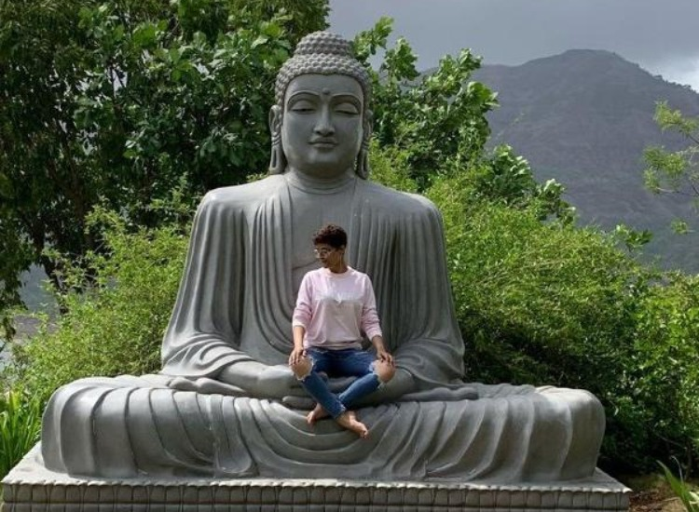
Hollywood Degrades The Buddha
The film "Hollywood Buddha" showed a complete lack of cultural sensitivity by causing outrage and protest on the streets of Sri Lanka, Malaysia and Burma when the designer of the film's poster decided to show the lead actor sitting on the Buddha statue , an act of clear degradation against something holy..
How Lack of Cultural Awareness Can Cost A Business Big
McDonald's spent thousands on a new TV ad to target the Chinese consumer. The ad showed a Chinese man kneeling before a McDonald's vendor and begging him to accept his expired discount coupon.
The ad was pulled due to a lack of cultural sensitivity on McDonald's behalf. The ad caused uproar over the fact that begging is considered a shameful.

Slide 37

The more culturally aware you are the more socially intelligent you become.

Slide 38
The more you know about culture etiquette the less likely you experience a culture shock.

Slide 39

06
Culture shock
« In an unfamiliar culture,it is wise not to offer no innovations, no suggestions, or lessons.”
Maya angelo

Slide 40
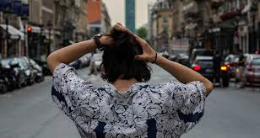
Culture shock refers to the impact of moving from a familiar culture to one that is unfamiliar.
A normal reaction to a new environment where you are no longer in control as you have been at home.
A feeling of disorientation experienced by someone when they are suddenly subjected to an unfamiliar culture and way of life.
This unfamiliarity can lead to symptoms such as:

Slide 41

Anxiety
Frustration
Confusion
Loneliness
Homesickness

Slide 42
Culture shock: stages
01
Honeymoon phase
02
Culture shock
03
04
Adjustment
Adaptation

Slide 43
1: Honeymoon phase:You are very positive, curious, and anticipate new exciting experiences. You even idealize the host culture.
3. Adjustment : You feel more relaxed and develop a more balanced, objective view of your experience
2. Culture shock; The host culture is confusing or the systems are frustrating.
4. Adaptation: You feel a new sense of belonging and sensitivity to the host culture.

Slide 44
Do you think that cultural awareness is an important part of personal growth?

Slide 45
Guess the meaning of the underlined expressions
The head of the chinese delegation felt a loss of face.
He was being given the cold shoulder by his Thai colleagues.
In business, cultural misunderstandings may burn the bridges.
The state or circumstance of having lost the respect of other people
Ignored
Destroy relationships

Slide 46
07
Idioms
An idiom is a group of words that are used as a common expression whose meaning is not easily deduced from the literal words within.

Slide 47
Match the bolded phrases to their meanings
I’m sorry but I just can’t seem to wrap my head around it. The dining etiquette is so confusing.
2. They’ve jumped out of the frying pan into the fire when they settled in Italy .
3. He was on cloud nine when he moved to the US.
4. After nearly a year in Japan I started to feel blue
5.You're going to have to step on a few peoples' toes if you want to get ahead in this business..
D
a. Feeling depressed or disconnected.
b. Extremely happy and excited:
c. From a bad or difficult situation to one that is even worse.
d. Not to understand
e. To insult, offend, or upset.
C
B
A
E

Slide 48
How do you think she has such a perfect English pronunciation?
She might/could/may have lived in the US before!

Slide 49
Deduction in the past

Slide 50
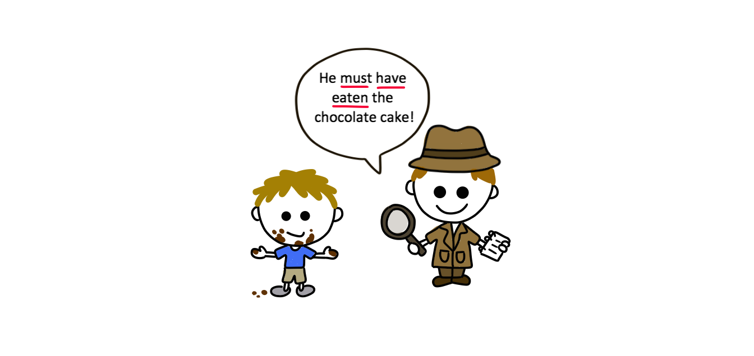
Deduction in the past
To make guesses or deductions about past actions or states we use a past modal of deduction.
Modal verb +have+past participle
Also called the perfect infinitive

Slide 51
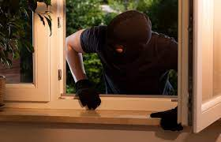
Notice the difference!
He must have climbed through the window.
Very sure , we think it’s possible 99%
He can’t/couldn’t have come through the window.
Very sure , we think it’s impossible 99%
He may/might/could have escaped through the window.
We think it’s possible 50%.

Slide 52
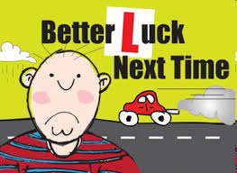
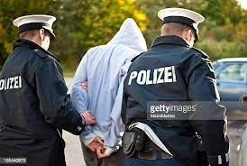
Let’s practice: how many past deductions can you make?
He must have failed.
He can’t have passed.
It might have been his first test.
They must have caught him.
He can’t have escaped.
They may have sent him to prison for a long time.

Slide 53
Let’s recapitulate
She can't have driven there. Her car keys are still here.
The thief must have had a key. The door was locked and nothing was broken
99% sure impossible
I think I might have left the air conditioning on. Please can you check?
99% sure possible
50% possible

Slide 54
Complete the sentences with the appropriate modal verb
You delighted when you heard you’d won the lottery. (To be)
I thought I saw John in town this morning but it ….him – he’s in Greece this week. (to be)
I can’t find my purse. I it in the supermarket but I just don’t know. (to leave)
The thieves in through the window. Look – it’s still open. (to come)
The thieves by car but we can’t be sure.(to escape)
Oh no! Where’s my car? Someone it! (to steal)
I it in the supermarket – I had it on the bus on the way home. (to leave)
must have been
can’t have been
could have left
must have come
might have escaped
must have stolen
can’t have left

Slide 55
Choose the correct form for the following:
1) A: Look at her diamond ring. B: Yes, it __ cost a fortune.
couldn't have must have
2) A: Patrick isn't answering his phone. B: He __ switched it off or left it at home.
must have might have
3) A: Where's Sarah? B: She said she had an important meeting tomorrow. She __ working late.
couldn't be must be
4) A: Peter said you were an architect. B: He __ confused me with someone else or maybe he misunderstood me. I'm a vet.
Can’t have must have
5) A: I can't find my wallet. B: You __ looked properly. I put it on the table myself.
could have couldn’t have
'
6) A: Does John know about the party? B: I suppose so. He __ have been told by Sarah but then again maybe not.
can't have might have

Slide 56
Thank you
Any questions?

